Slide 1
University of Technical Education of Ho Chi Minh City
NETWORKING ESSENTIALS
Chapter 5.
IP Addressing
Huynh Nguyen Chinh
Notes:
1

Slide 2
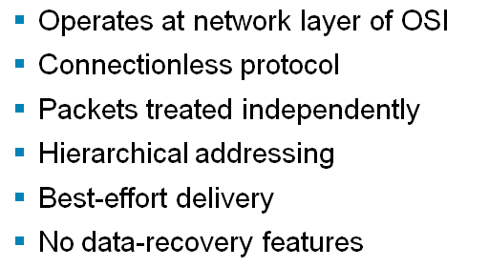
Internet Protocol Characteristics

Slide 3
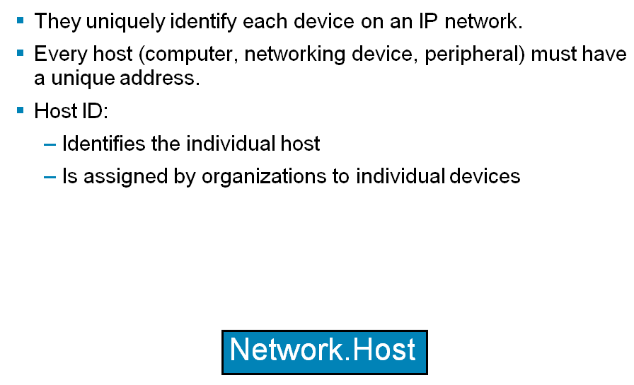
Why IP Addresses?
Notes:
Purpose: this figure states the chapter objectives.
Emphasize: Read or state each objective so each student has a clear understanding of the chapter objectives.

Slide 4
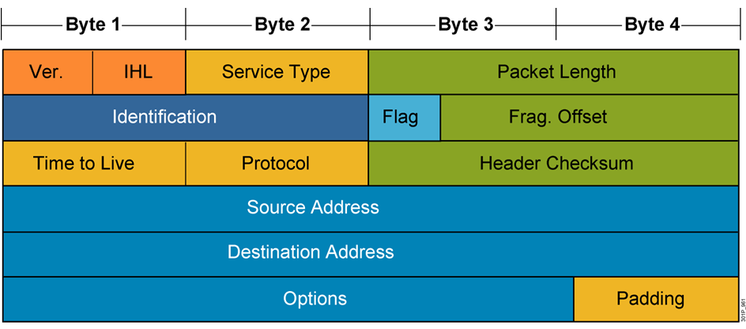
IP PDU Header

Slide 5
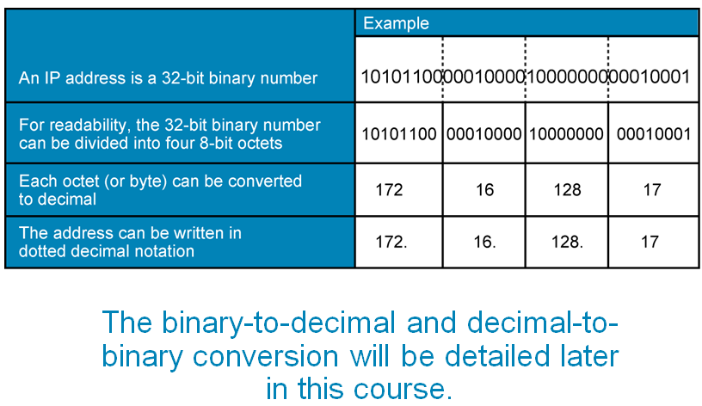
IP Address Format: Dotted Decimal Notation

Slide 6
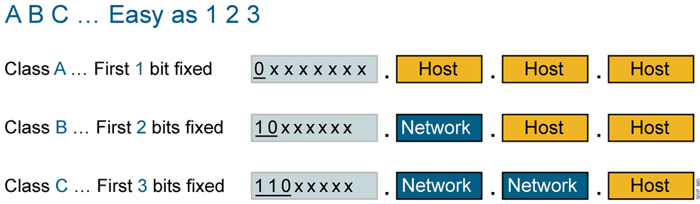
IP Address Classes: The First Octet
Notes:
Purpose: This slide discuss the initial configurations on the routers and switches.
Note: There is no setup mode on the Catalyst 1900 switch.

Slide 7
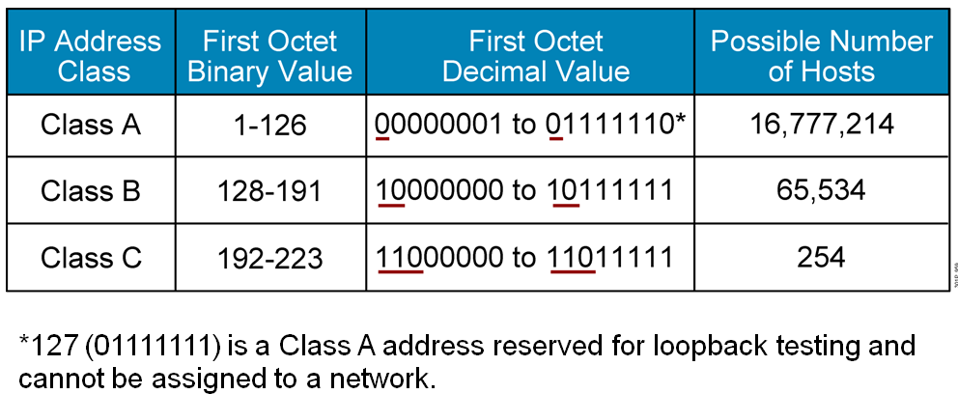
IP Address Ranges
Notes:
Purpose: This slide discuss the initial configurations on the routers and switches.
Note: There is no setup mode on the Catalyst 1900 switch.

Slide 8
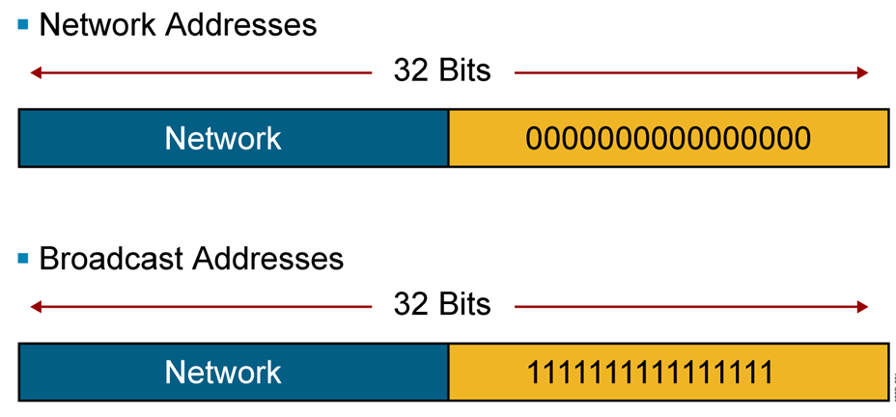
Reserved Address

Slide 9
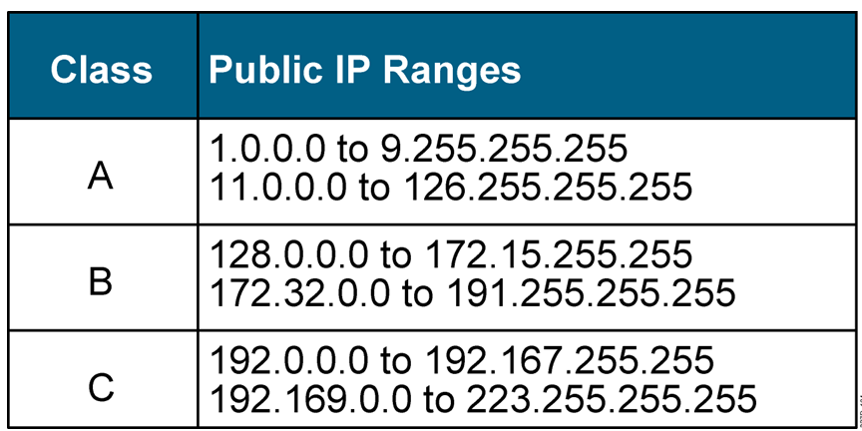
Public IP Addresses

Slide 10
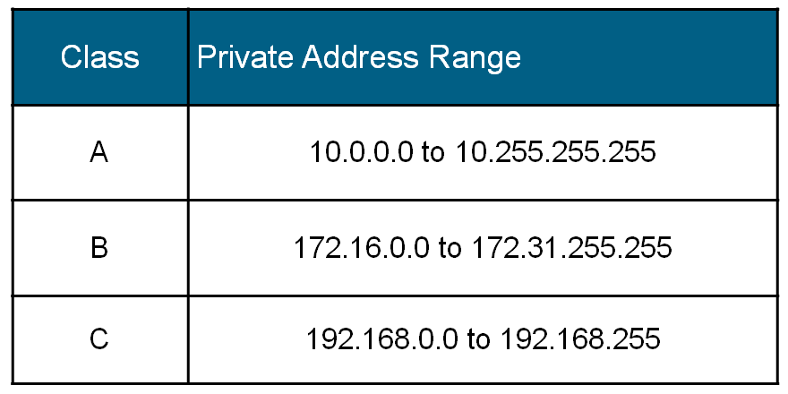
Private IP Addresses

Slide 11
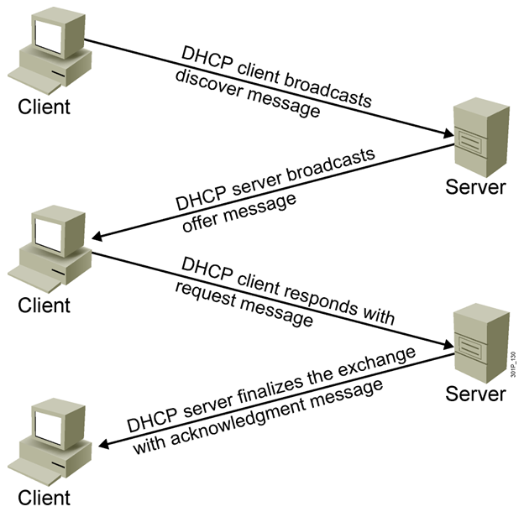
DHCP

Slide 12
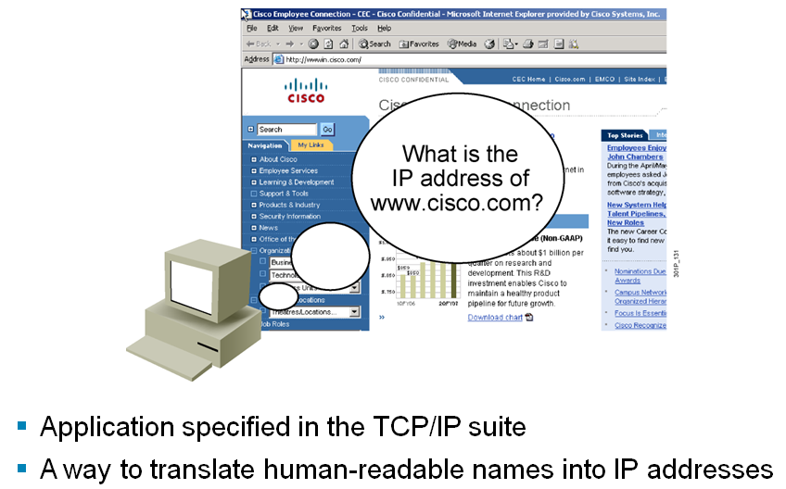
DNS

Slide 13
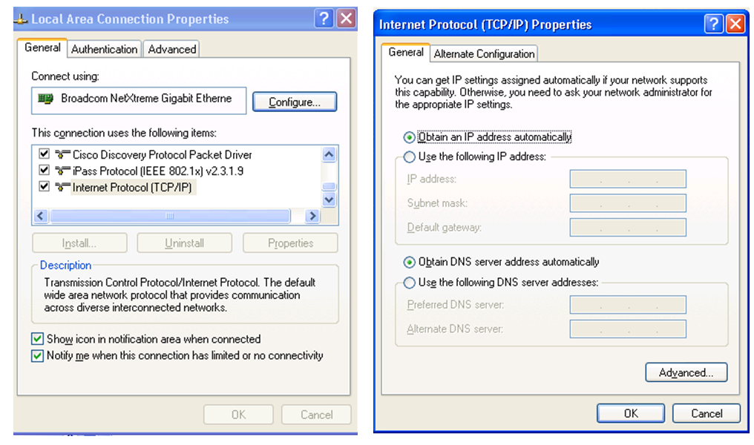
Network Connection

Slide 14
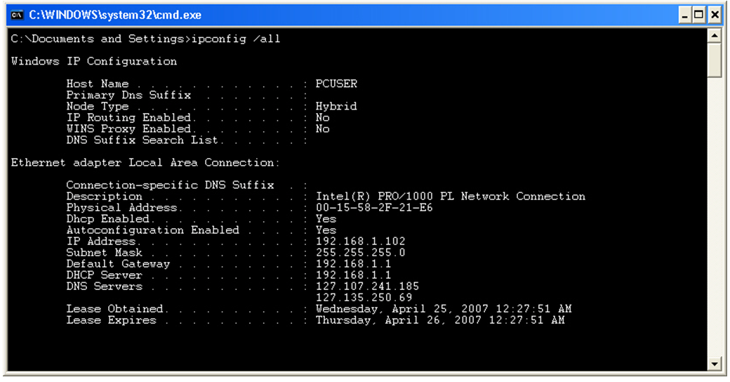
ipconfig

Slide 15
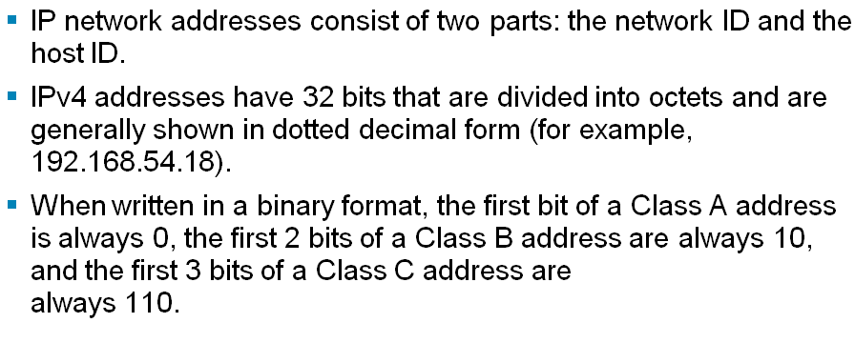
Summary

Slide 16
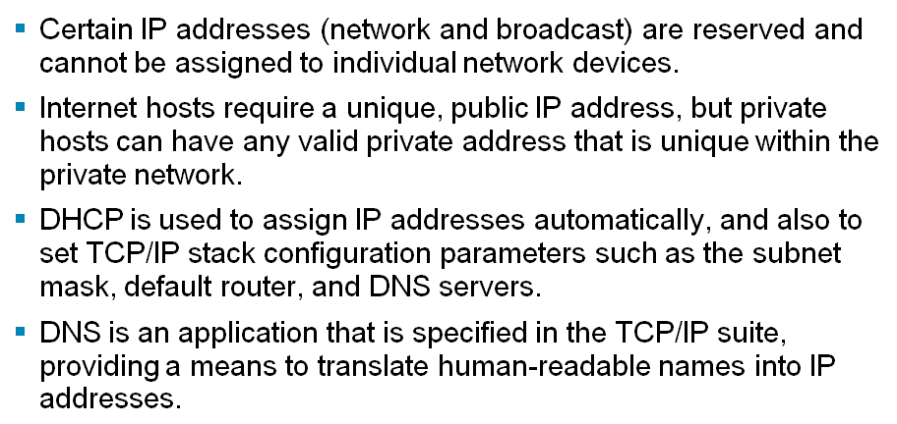
Summary (Cont.)

Slide 17
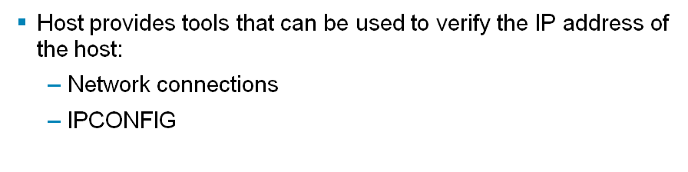
Summary (Cont.)

Slide 18
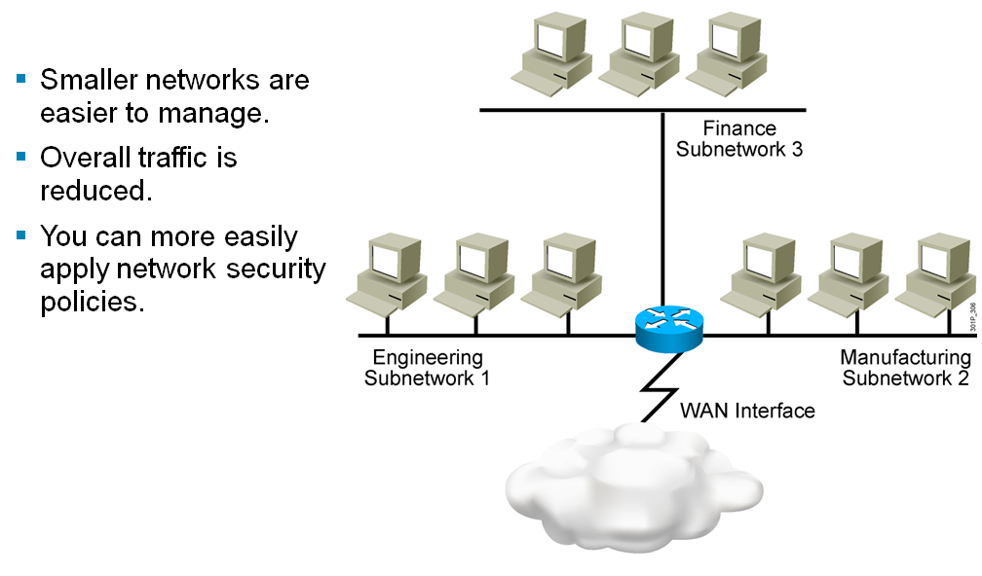
Subnetworks
Notes:
Purpose: this figure states the chapter objectives.
Emphasize: Read or state each objective so each student has a clear understanding of the chapter objectives.

Slide 19
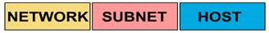
Kỹ thuật Subnetting (tt)
Kỹ thuật Subnetting (chia mạng con) là kỹ thuật sử dụng (mượn) một số bit phần Host_ID tham gia vào phần Network_ID.
Khi đó, để nhận diện ra một mạng con (subnet) ta dùng đến Subnet Mask.
Subnet mask có độ dài 32 bit, chia làm 4 octet, mỗi phần 8 bit cũng giống như địa chỉ IP Các bit 1: chỉ ra các bit tham gia vào phần NetWork_ID Các bit 0: các bit tham gia vào phần Host_ID

Slide 20
Kỹ thuật Subnetting (tt)
Công thức tính ra một Subnet:
IP_Address AND Subnet_Mask =Network_Address
Gọi n là số bit mượn phần Host_ID, h là số bit phần Host_ID còn lại thì:
- Số lượng mạng con (subnet) sinh ra là: 2^n
- Số lượng host/mạng con = 2^h-2

Slide 21
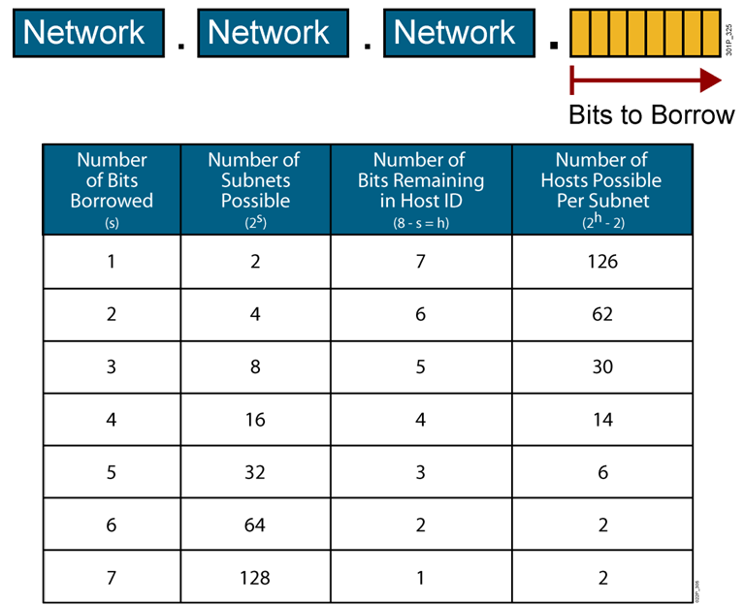
Possible Subnets and Hosts for a Class C Network
Notes:
Purpose: This slide discuss the initial configurations on the routers and switches.
Note: There is no setup mode on the Catalyst 1900 switch.

Slide 22
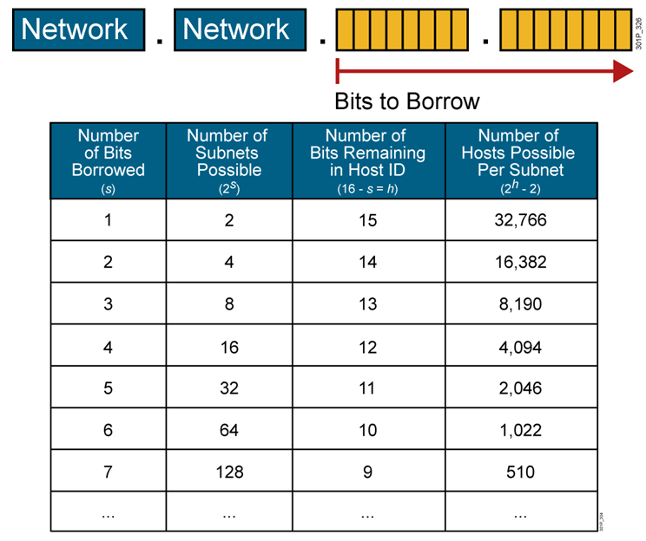
Possible Subnets and Hosts for a Class B Network
Notes:
Purpose: This slide discuss the initial configurations on the routers and switches.
Note: There is no setup mode on the Catalyst 1900 switch.

Slide 23
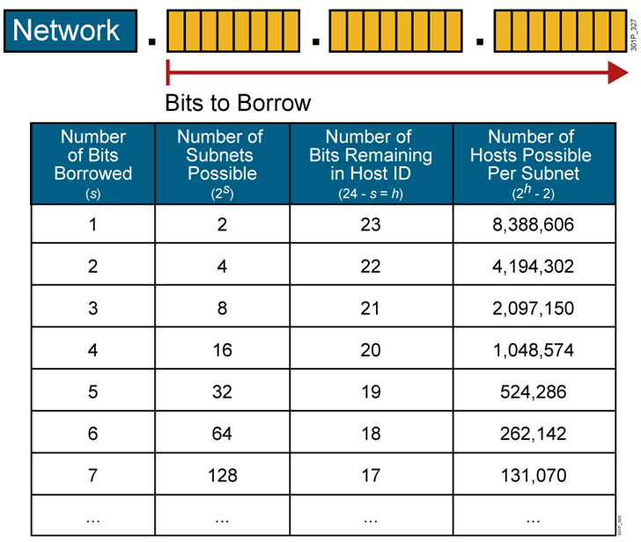
Possible Subnets and Hosts for a Class A Network
Notes:
Purpose: This slide discuss the initial configurations on the routers and switches.
Note: There is no setup mode on the Catalyst 1900 switch.

Slide 24
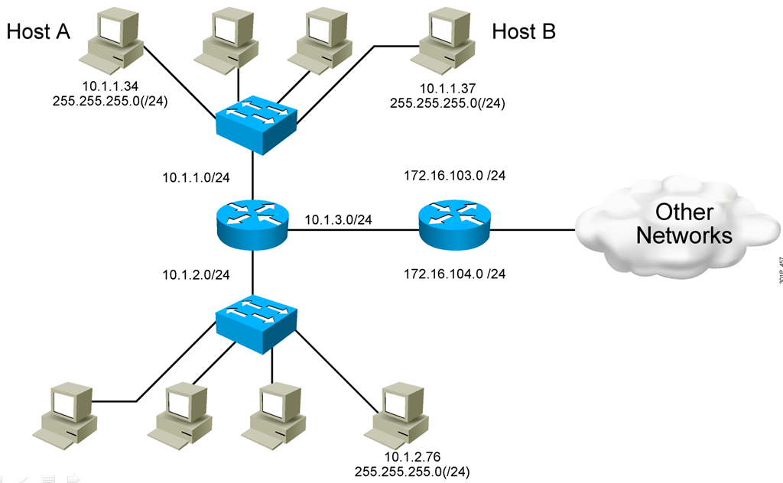
End System Subnet Mask Operation

Slide 25
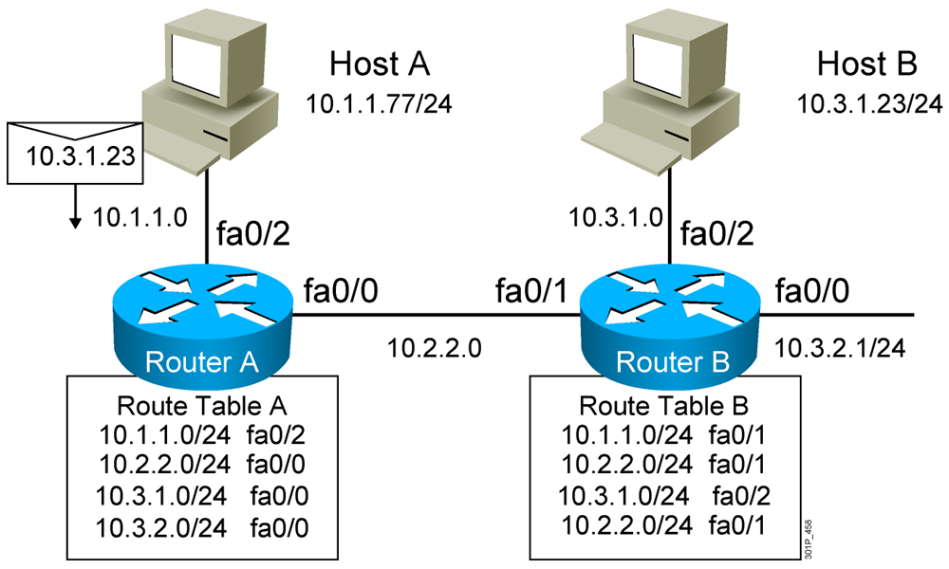
How Routers Use Subnet Masks

Slide 26
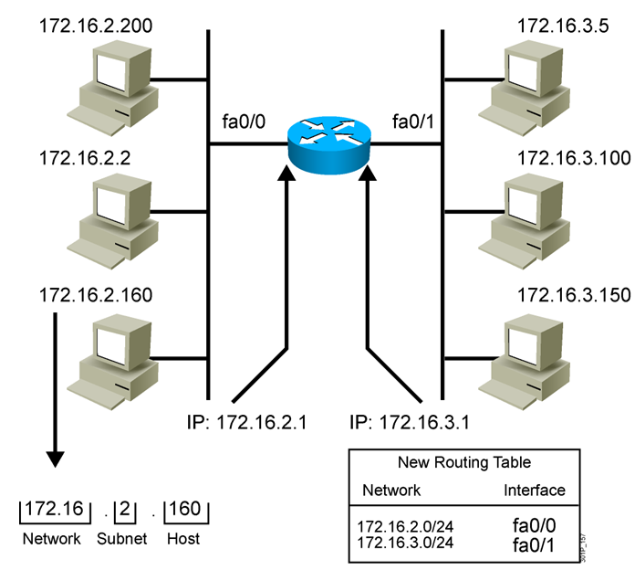
Applying the Subnet Address Scheme

Slide 27
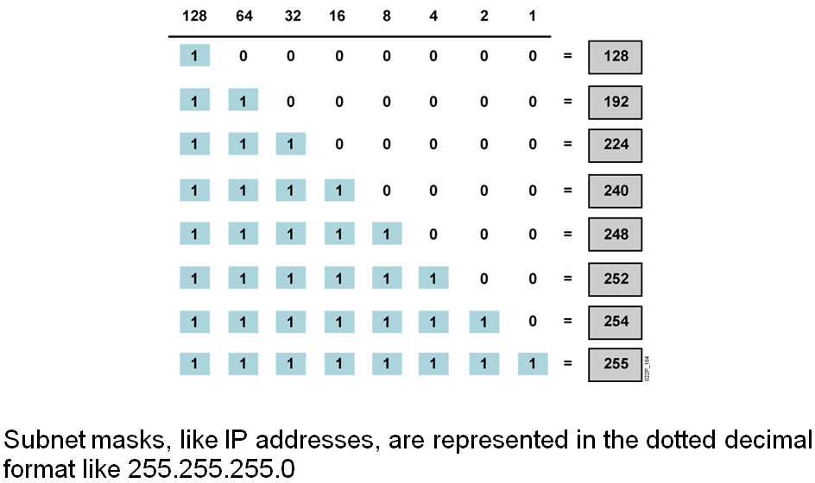
Octet Values of a Subnet Mask

Slide 28
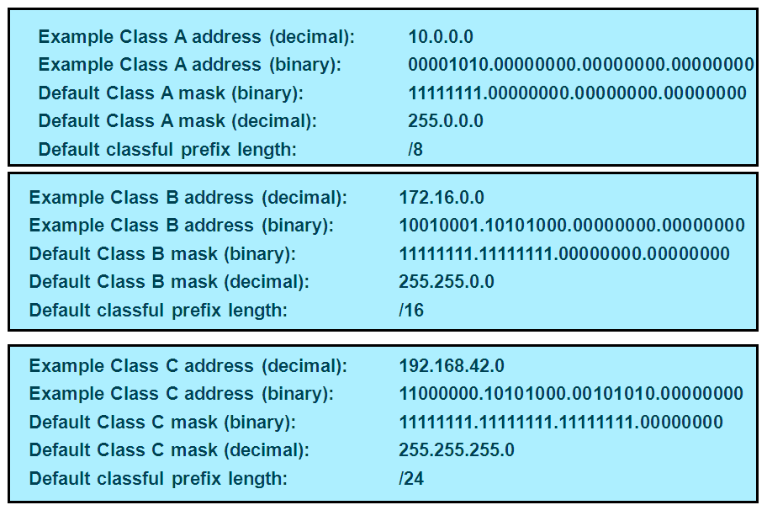
Default Subnet Masks

Slide 29
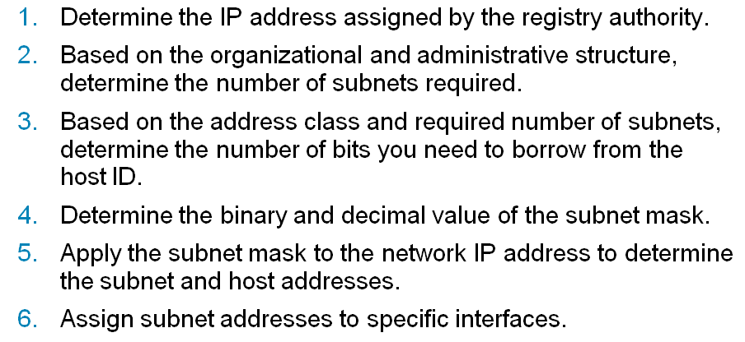
Procedure for Implementing Subnets

Slide 30
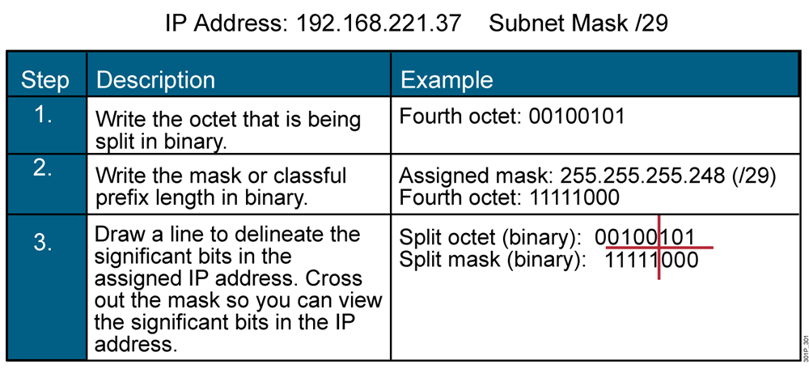
Eight Easy Steps for Determining Subnet Addresses

Slide 31
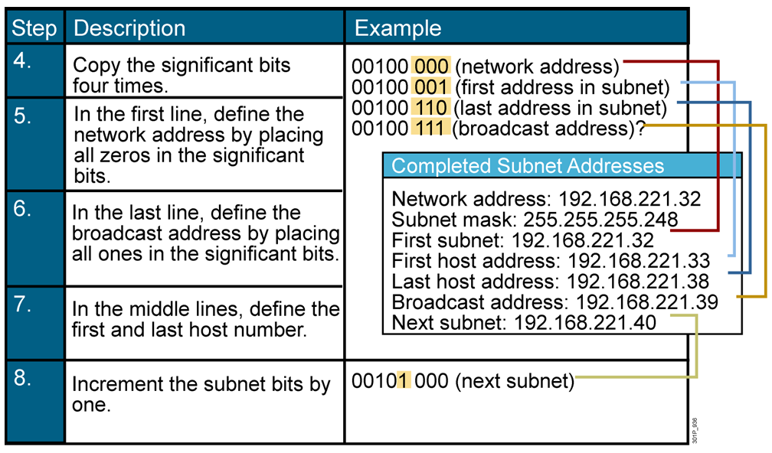
Eight Easy Steps for Determining Subnet Addresses (Cont.)

Slide 32
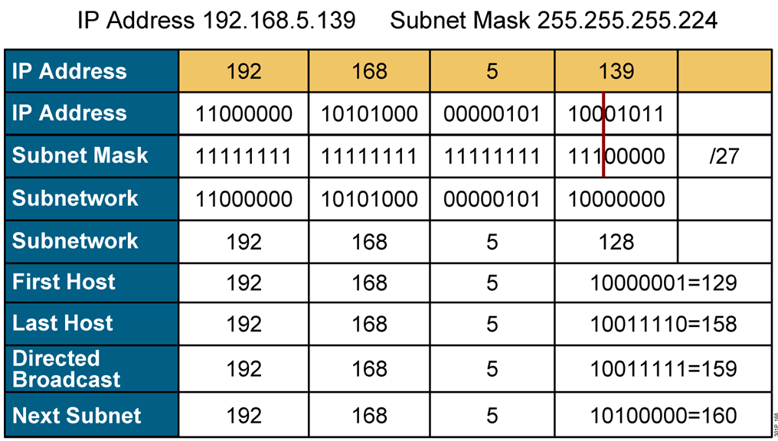
Example: Applying a Subnet Mask for a Class C Address

Slide 33
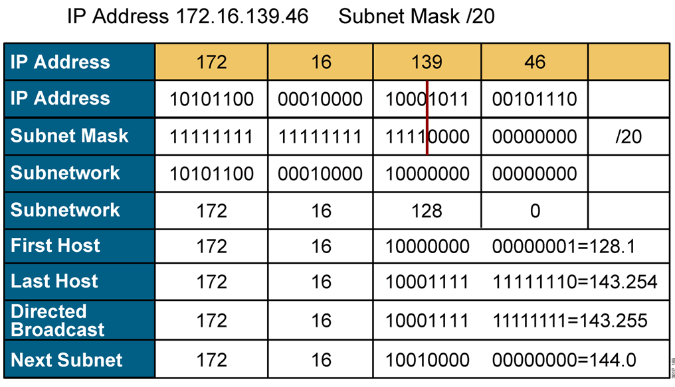
Example: Applying a Subnet Mask for a Class B Address

Slide 34
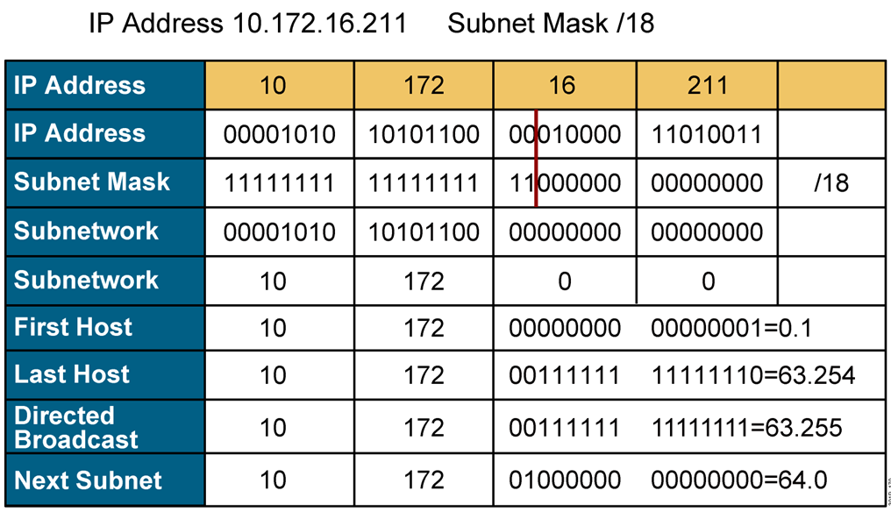
Example: Applying a Subnet Mask for a Class A Address

Slide 35
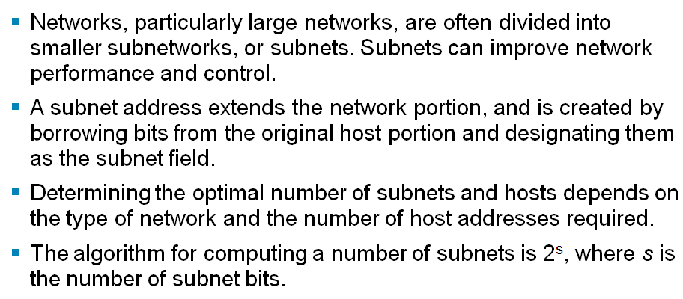
Summary

Slide 36
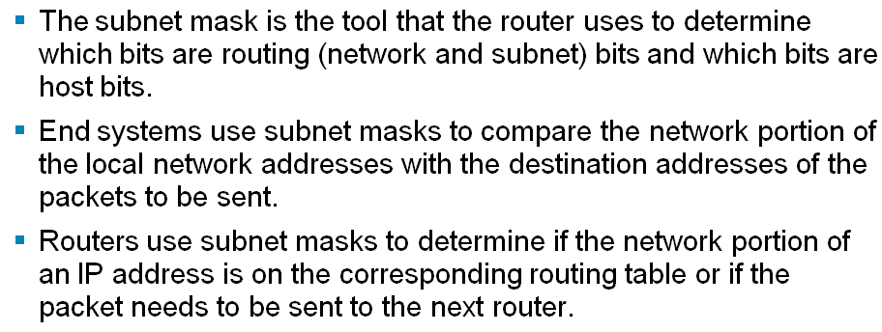
Summary (Cont.)

Slide 37
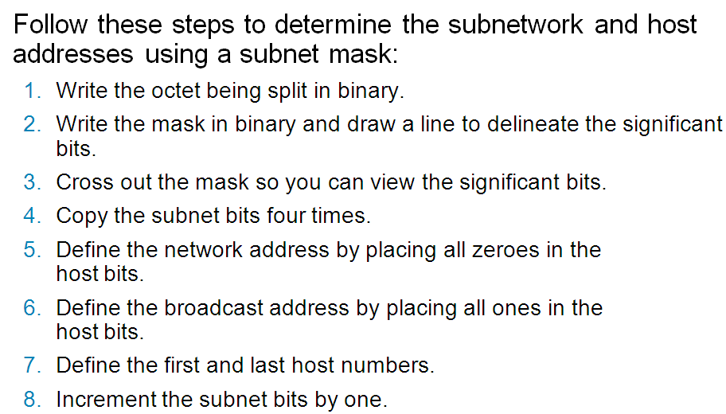
Summary (Cont.)

Slide 38
Exercises: IP Class Recognize
Recognize these features:
☞ Class of IP address
☞ Public or Private
☞ Default Subnet Mask

Slide 39
Exercises: IP Class Recognize
Apply to the following IP address:
a. 171.10.1.1
b. 172.31.1.1
c. 6.12.2.1
d. 10.22.22.10
e. 192.168.1.10
f. 221.222.200.1
g. 129.6.5.4
h. 172.18.16.1
I. 191.168.1.1
j. 166.64.12.12

Slide 40
Exercises: IP Subnetting
Subnetting
Pls determine these features:
☞ Default SM and Current SM
☞ Number of network bit
☞ Number of host bit
☞ Number of Subnet bit
☞ Number of usable subnet
☞ Number of usable host per subnet

Slide 41
Exercises: IP Subnetting
Apply to the following IP address:
a.192.160.1.0/24
Borrow 3 bits
b.171.16.0.0/16
Borrow 6 bits
d.198.10.10.0/29
c.10.16.1.0/8
Borrow 20 bits
f.192.169.12.0/24
Borrow 3 bits
e.179.18.0.0/16
Borrow 11 bits
h.191.172.0.0/20
i.126.172.0.0/30
g.66.65.0.0/28

Slide 42
Question 1
Exercises
The IP address 131.107.0.0 is a class B address.
What is the range of binary values for the first octet in this address class?
10000000 - 11111111
B. 00000000 - 10111111
C. 10000000 - 10111111
D. 10000000 - 11011111
E. 11000000 - 11101111

Slide 43
Question 2
Exercises
What is the network address for a host with
the IP address 123.200.8.68/28?
123.200.8.0
B. 123.200.8.32
C. 123.200.8.64
D. 123.200.8.65
E. 123.200.8.31
F. 123.200.8.1

Slide 44
Question 3
Exercises
Using a class C address range 192.168.21.12
your network needs twenty-eight subnets.
Which subnet mask should you use?
255.255.0.28
255.255.255.0
255.255.255.28
255.255.255.248
255.255.255.252

Slide 45

Question 4
Exercises
You need to configure an IP address for workstation TestKingA. Based on the information shown above, what IP address should be assigned to this host?
A. 192.168.1.159/28
B. 192.168.1.145/28
C. 192.168.1.160/28
D. 192.168.1.144/28
E. 192.168.1.143/28
Answer: B

Slide 46
Question 5
Exercises
Which of the following addresses can be assigned to a host when using a subnet mask of 255.255.254.0? (Select three)
A. 113.10.4.0
B. 186.54.3.0
C. 175.33.3.255
D. 26.35.2.255
E. 152.135.7.0
F. 17.35.36.0
Answer: B, D, E

Slide 47
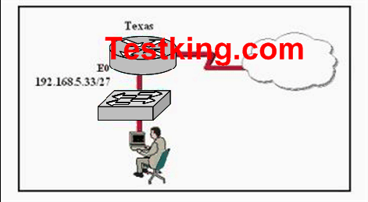
Question 6
Exercises
Answer: C
Based on the information above, which IP address should be assigned to the host?
A. 192.168.5.5 B. 192.168.5.32
C. 192.168.5.40 D. 192.168.5.63
E. 192.168.5.75 F. None of the above

Slide 48
Question 7
Exercises
If a host on a network has the address 172.16.45.14/30, what is the address of the subnetwork to which this host belongs?
A. 172.16.45.0
B. 172.16.45.4
C. 172.16.45.8
D. 172.16.45.12
E. 172.16.45.18
Answer: D

Slide 49
Exercises
Question 8
Give the following IP: 172.16.80.92/20, 172.16.32.100/20 and 172.16.65.100/20.
What are the broadcast addresses of the subnets in which these IP address belong to?
(Select three options.)
A. 172.16.82.255
B. 172.16.95.255
C. 172.16.64.255
D. 172.16.32.255
E. 172.16.47.255
F. 172.16.79.255
Correct Answer : B , E , F

Slide 50
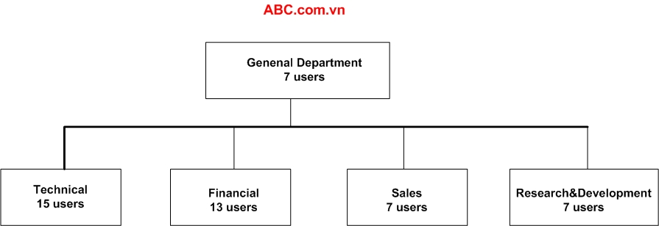
Question 9
ABC company is acquiring a new Class C IP network.
Which of the following subnet masks will provide one useful subnet for each department while still making allowance for enough usable host addresses per department as specified in the graphic?
A. 255.255.255.128
B. 255.255.255.192
C. 255.255.255.224
D. 255.255.255.240
E. 255.255.255.248
F. 255.255.255.252
Correct Answer : C

Slide 51
Exercises
Question 10
You are a network technician at NewStar.vn. Your company has a larger 172.12.0.0 network that you want to divide into subnets. You want each subnet to support 459 hosts. You also want to provide the maximum number of subnets.
Which network mask should you use?
A. 255.255.0.0
B. 255.255.128.0
C. 255.255.224.0
D. 255.255.254.0
Correct Answer : D

Slide 52
Exercises
Question 11
You are a network administrator at Seibels. You must configure a new subnetwork at the Seibels branch office in Berlin. You have been provided with the subnet mask of 255.255.255.224. You want to assign IP addresses to hosts on the subnet.
Which of the following IP addresses would you use? (Choose all that apply.)
A. 16.23.118.63
B. 87.45.16.159
C. 92.11.178.93
D. 134.178.18.56
E. 192.168.16.87
F. 217.168.166.192
Correct Answer : C, D, E

Slide 53
Exercises
Question 12
You are a network technician at Zysese company. You have subnetted the 210.106.14.0 network with a /24 mask.
Your supervisor asks you how many usable subnetworks and usable host addresses per subnet this would
make provision for.
What would your response be?
A. 1 network with 254 hosts
B. 4 networks with 128 hosts
C. 2 networks with 24 hosts
D. 6 networks with 64 hosts
E. 8 networks with 36 hosts
Correct Answer : A

Slide 54
Exercises
Question 13
You have subnetted the 213.105.72.0 network with a /28 mask. How many usable subnetworks and usable host addresses per subnet will be provided?
A. 2 networks with 62 hosts
B. 6 networks with 30 hosts
C. 16 networks and 16 hosts
D. 62 networks and 2 hosts
E. 16 networks and 14 hosts
Correct Answer : E

Slide 55
Exercises
Question 14
You are a network technician at Fravo, Inc. You are planning a network installation for the company. The design requires 100 separate subnetworks, resulting in the acquisition of a Class B network address. Which of the following subnet masks will provide the 100 subnetworks required, if 500 usable host
addresses are required per subnet?
A. 255.255.0.0
B. 255.255.224.0
C. 255.255.254.0
D. 255.255.255.0
E. 255.255.255.224
F. 255.255.255.254
Correct Answer : C

Slide 56
Exercises
Question 15
You are a network technician at company. Company has a class C network license. The company requires 5 usable subnets. Each subnet must accommodate at least 18 hosts.
Which network mask should you use?
A. 225.225.224.0
B. 225.225.240.0
C. 225.225.255.0
D. 255.255.255.224
E. 225.225.255.240
Correct Answer : D

Slide 57
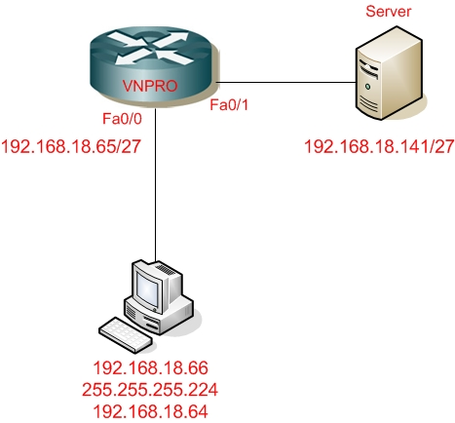
Exercises
Question 16
You are a network technician at NEWSTAR company. You add a new workstation to the network to
accommodate a new employee. The relevant section of the network is shown in the beside exhibit.
The employee is unable to connect to the server at IP address 192.168.18.141/27.
Can you identify the incorrectly configured network parameter in the workstation configuration?
A. IP address of the Ethernet 0 router interface
B. Server
C. Workstation default gateway
D. Workstation subnet mask
E. Workstation IP address
SPKT
Correct Answer : C

Slide 58
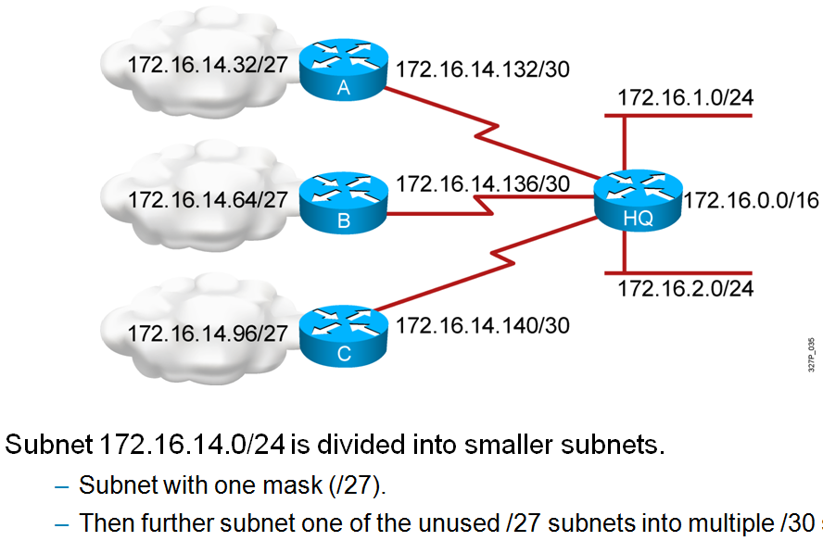
????
Variable-length Subnet Mask

Slide 59
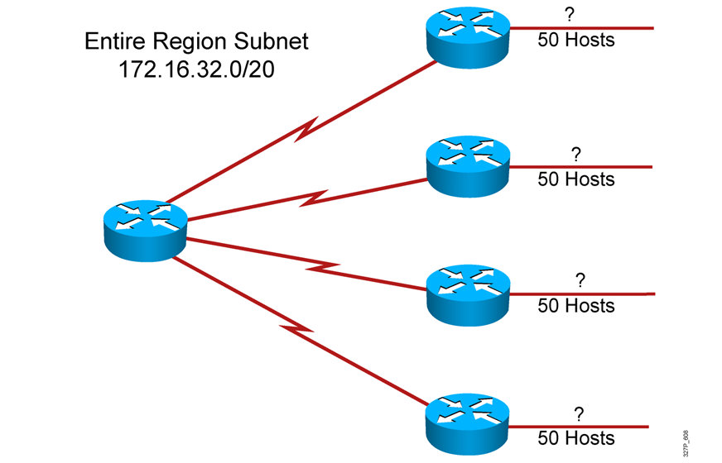
Variable-length Subnet Mask

Slide 60
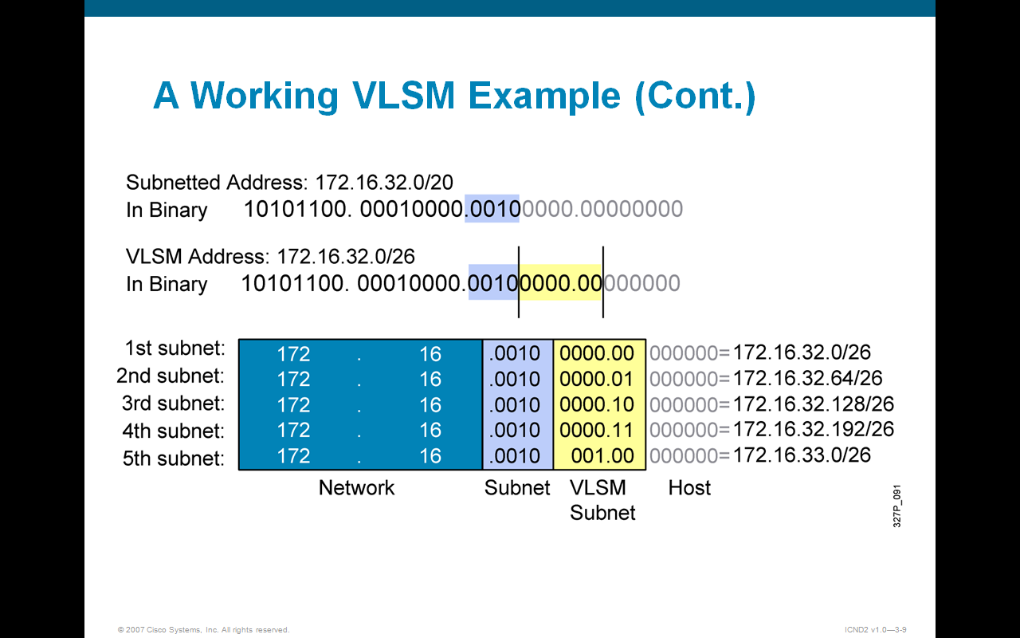
Variable-length Subnet Mask

Slide 61
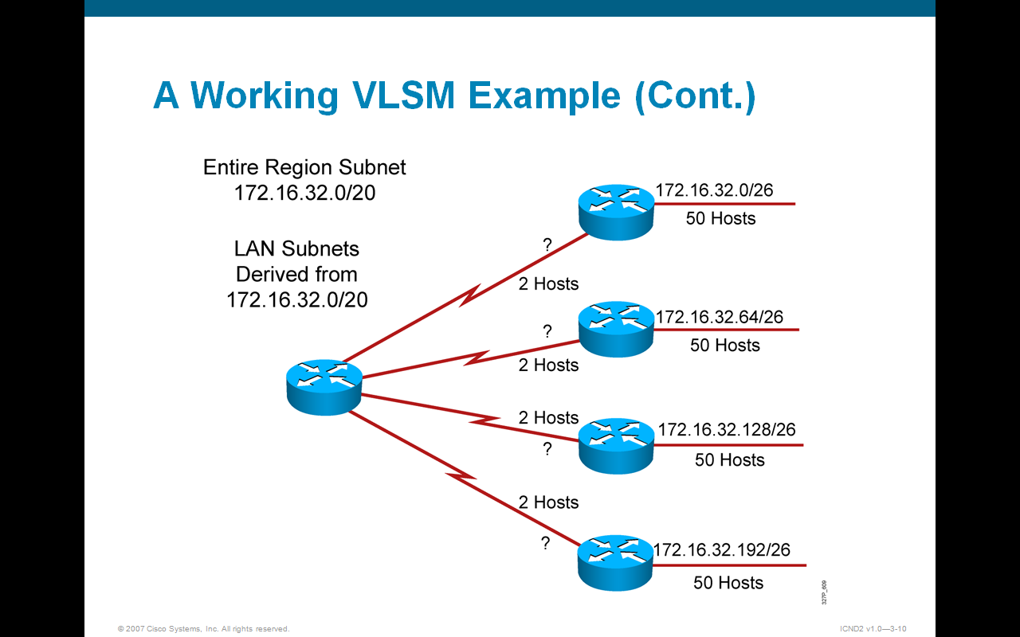
Variable-length Subnet Mask

Slide 62
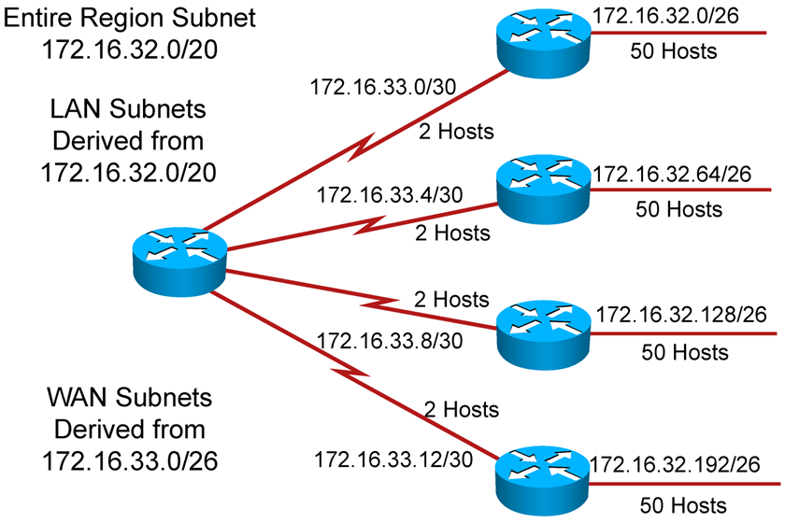
Variable-length Subnet Mask

